Slide 1



Adventure Works Sales Analysis
Presented By Group-2

Slide 2



Meet Our Team
Ms. Pratiksha Kudachi
Ms. Sakshi Masekar
Mr. Ankit
Mr. Hazique Khalique
Mr. Sahil Gajraj
Mr. Perwez Alam

Slide 3

Introduction
01
02 Overview
03
KPI’s
04 Insights and Recommendation
Agenda
05
Conclusion

Slide 4

The Adventure Works Sales Analysis Project examines sales performance, customer trends, and product insights using transactional and dimensional data. It calculates key metrics like Sales Amount, Production Costs, and Profit Margins, identifies seasonal trends, and visualizes findings through dashboards. The goal is to optimize inventory, enhance customer engagement, and drive revenue growth with data-driven strategies.
Over View

Slide 5

Some KPI’s & Additional Insights
Year Wise Sales
Month Wise Sales
Key Performance Indicators (KPI) Overview
Top 10 Customer By Sales
Total Category By Product Category Name.
KPI’s

Slide 6
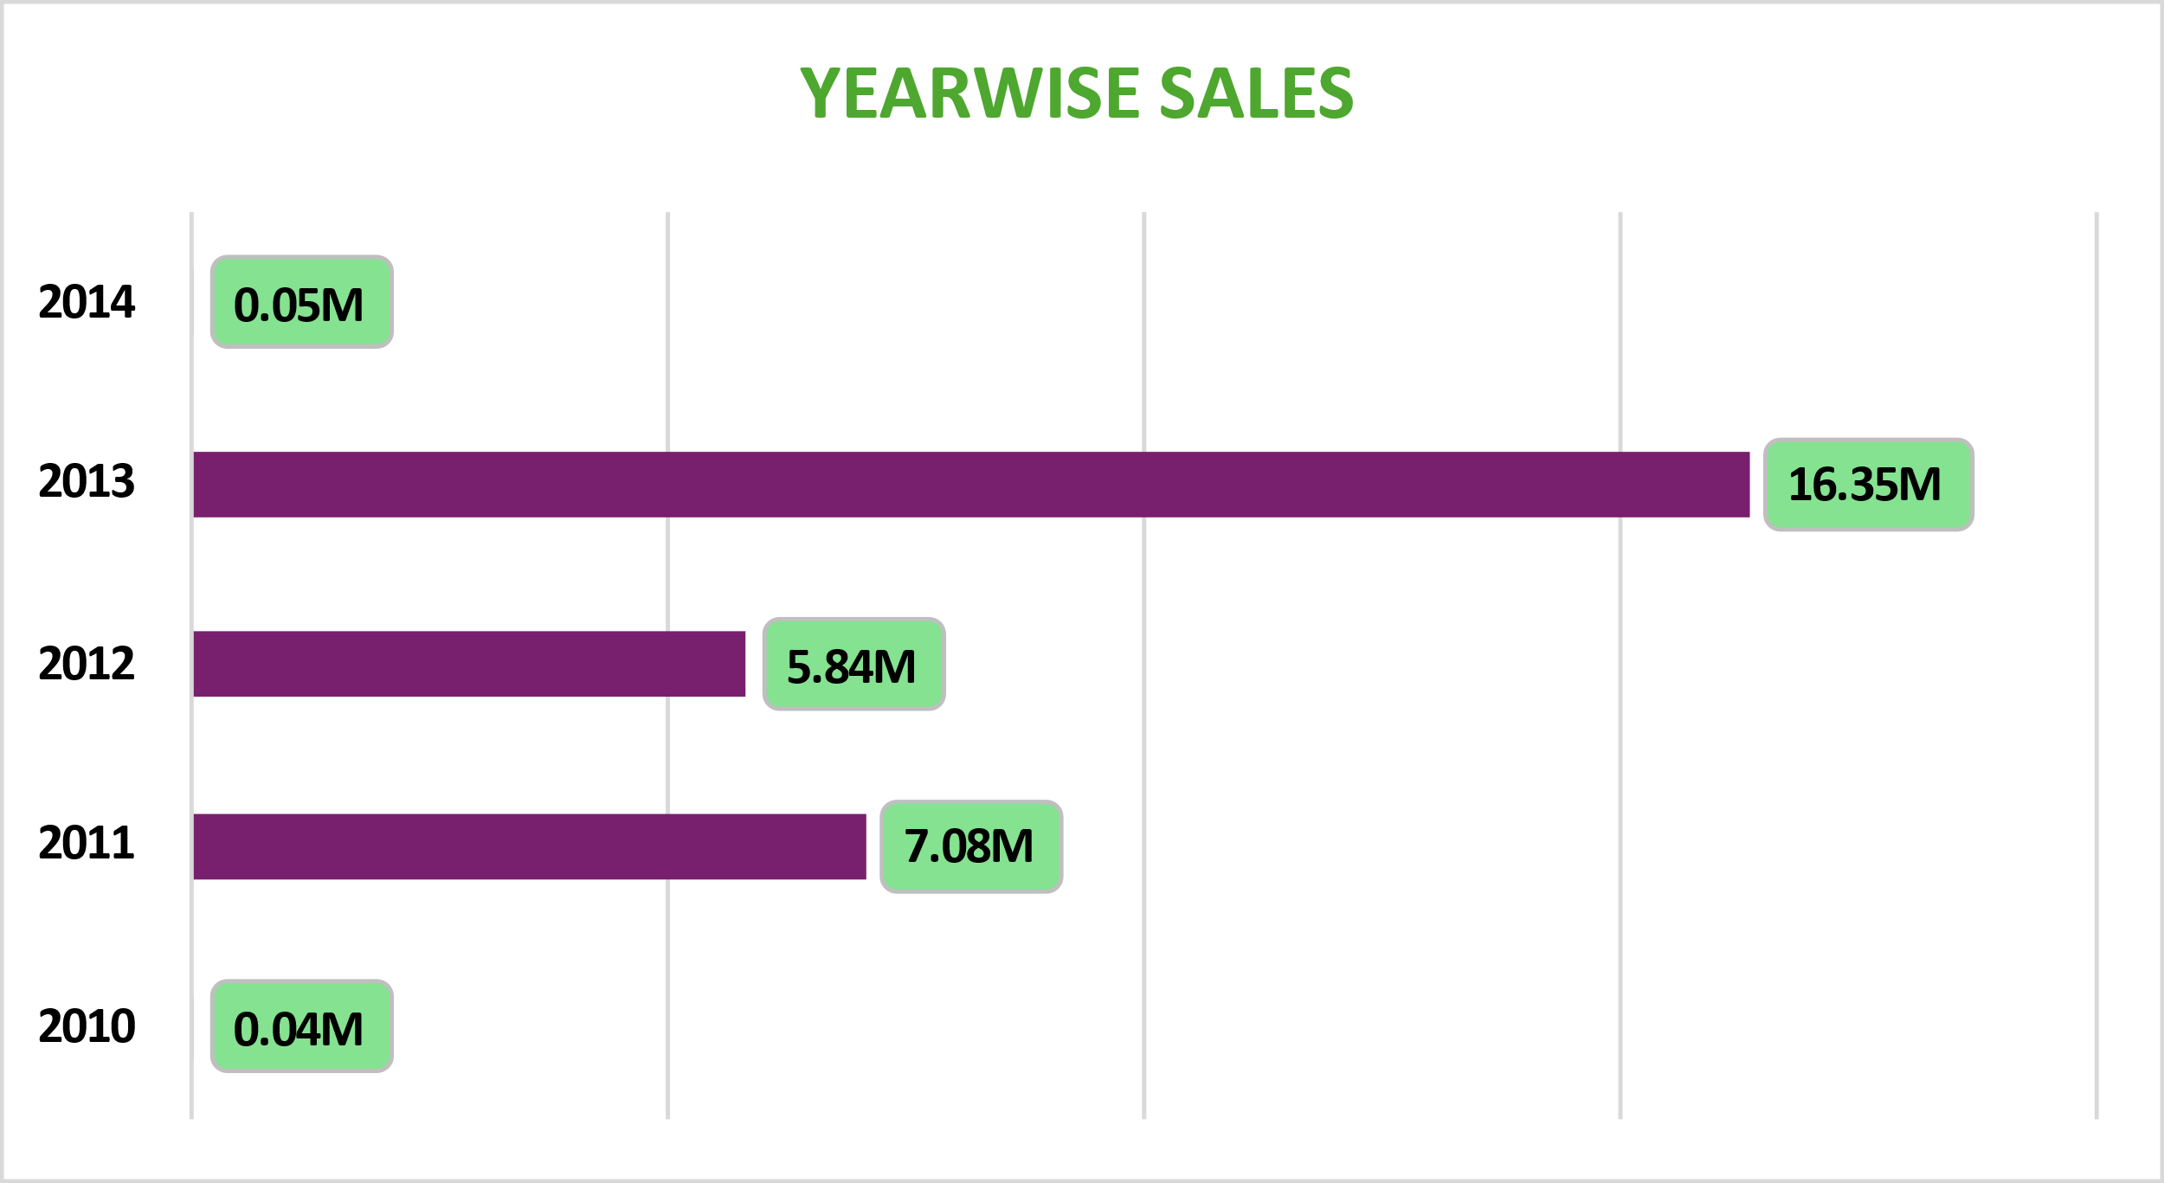
YearWise Sales
KPI 1
The horizontal bar chart shows year-over-year sales performance from 2010 to 2014. The data reflects significant growth, with 2013 being the highest revenue-generating year. This visualization helps in analyzing long-term business trends, measuring growth, and setting future financial goals

Slide 7
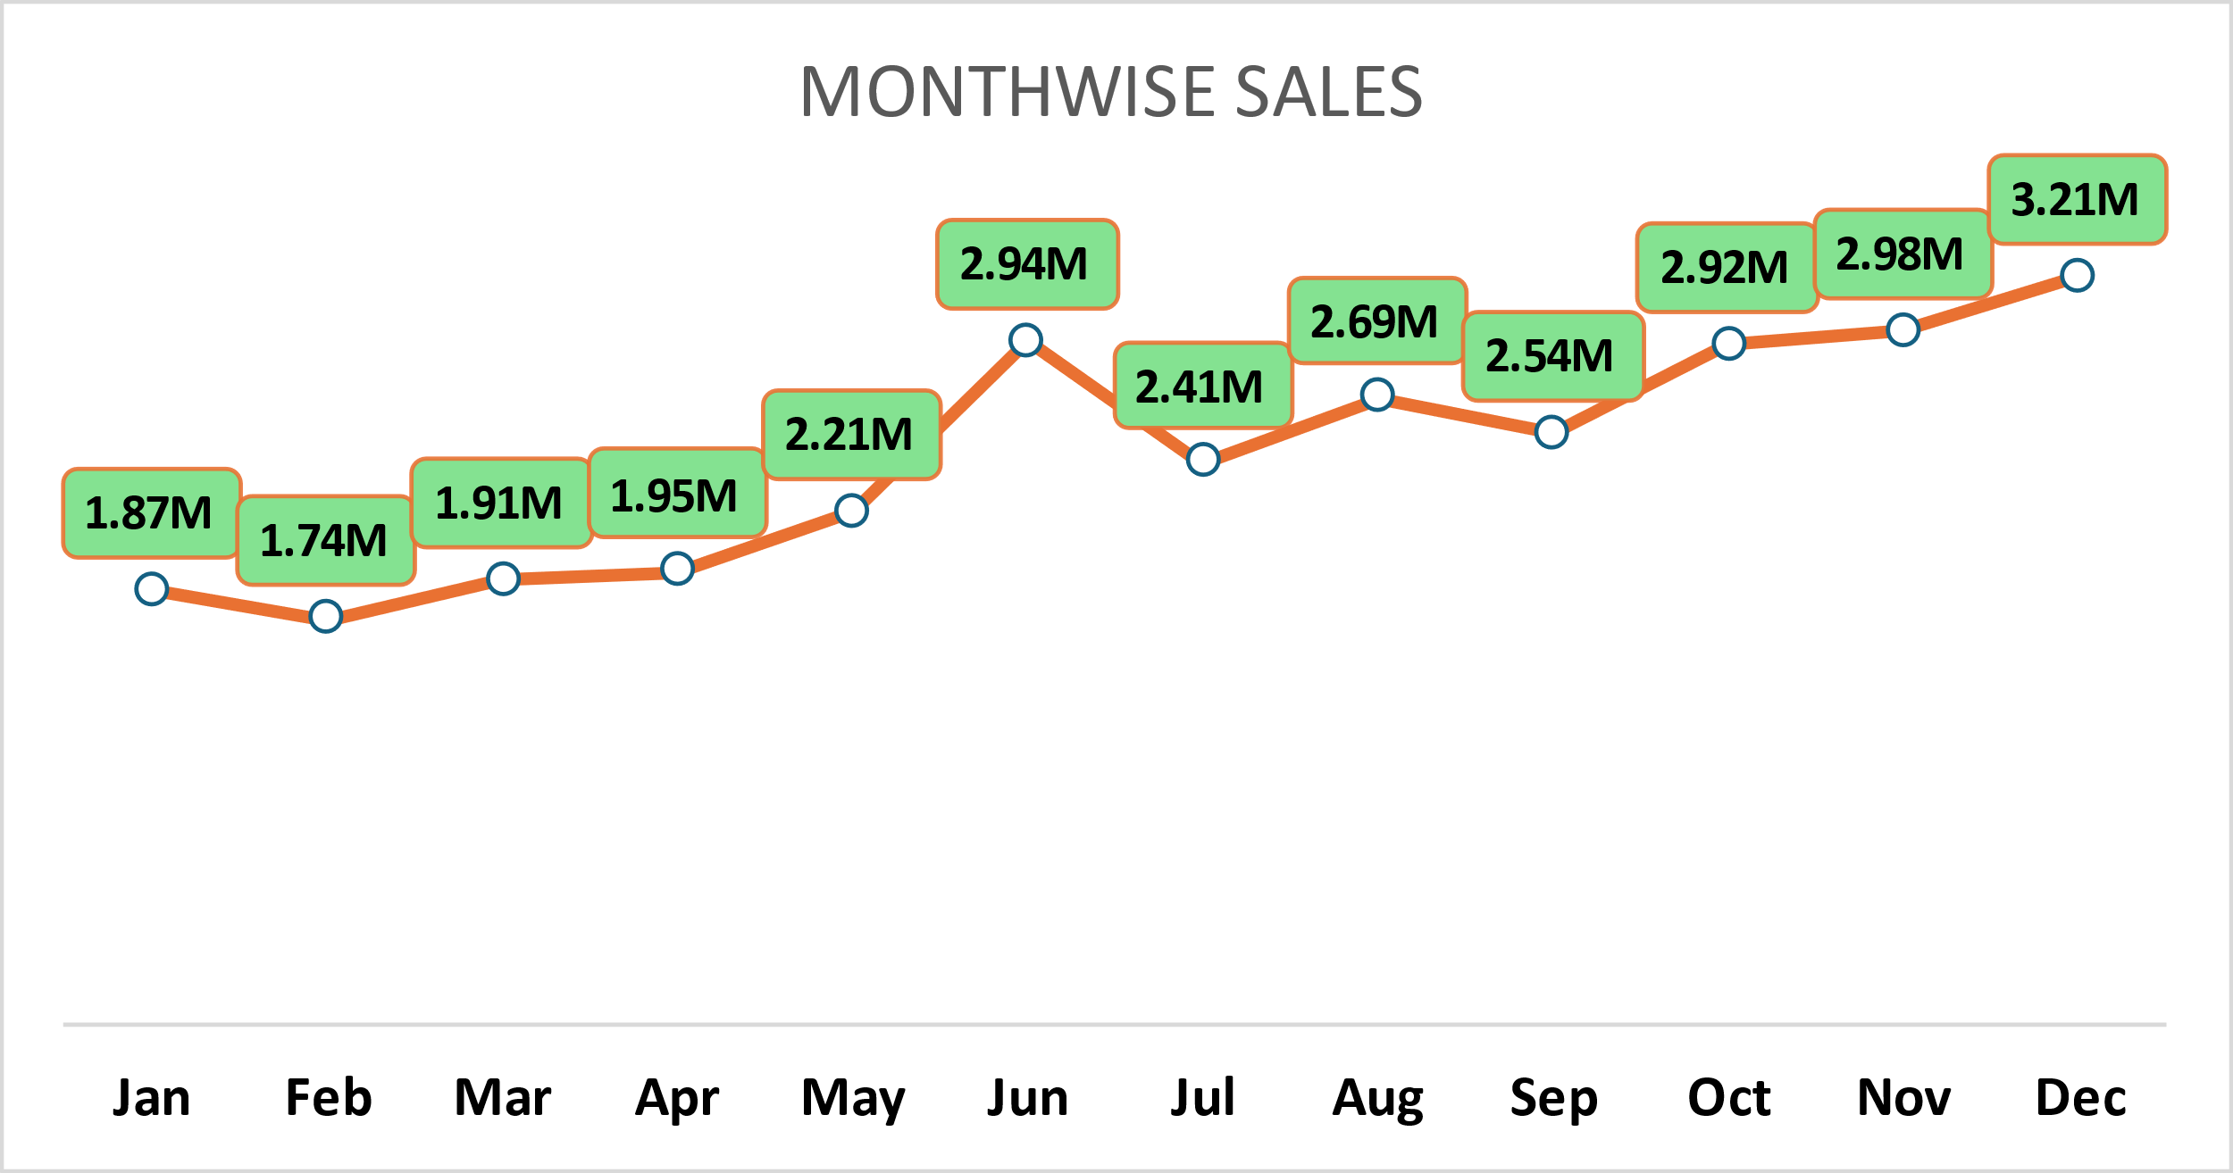
MonthWise Sales
KPI 2
This line chart displays the monthly sales performance for Adventure Works, showing a consistent growth pattern from January to December. The highlighted data points indicate monthly revenue figures, helping to identify seasonal sales trends and peak months. This visualization is essential for forecasting future sales, planning promotions, and optimizing inventory management

Slide 8
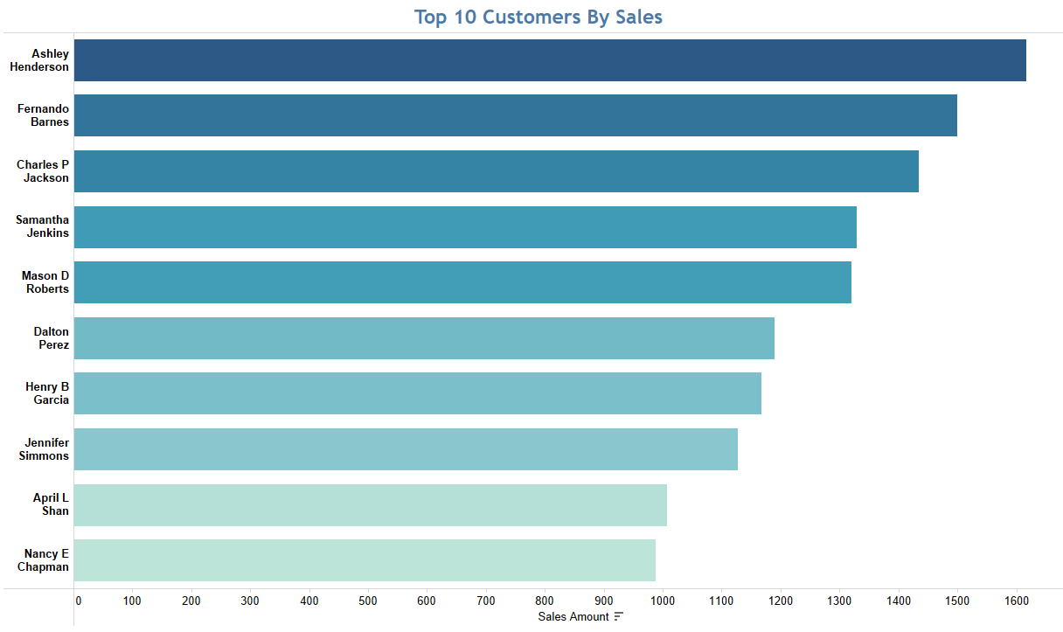
Top 10 Customers By Sales
KPI 3
This bar chart highlights the top 10 customers contributing the highest sales revenue for Adventure Works. By identifying high-value customers, the company can focus on personalized marketing, loyalty programs, and customer retention strategies. Understanding purchasing behavior helps in offering targeted promotions and improving customer relationships, ultimately driving higher revenue growth

Slide 9
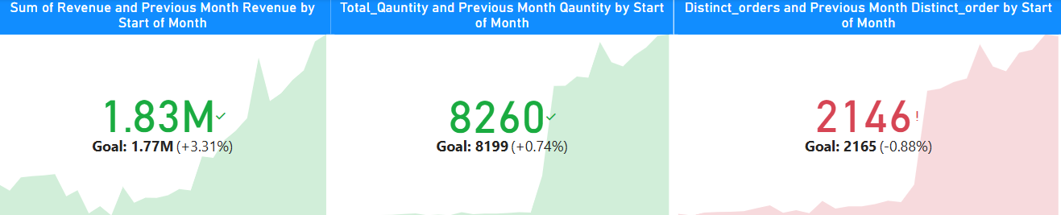
Key Performance Indicators (KPI) Overview
KPI 4
Key Performance Indicators (KPI) Overview
This KPI dashboard provides a snapshot of important business metrics, including total revenue, sales goals, and order volume. It helps track business performance against set targets, allowing decision-makers to take necessary actions for improving sales, meeting objectives, and adjusting marketing strategies.

Slide 10
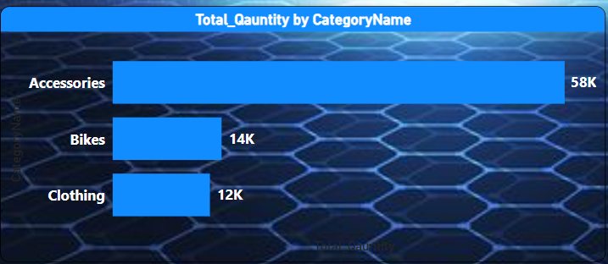
Total Category By Product Category Name
KPI 5
The bar chart represents the total number of units sold across different product categories: Accessories, Bikes, and Clothing. Accessories dominate the sales volume, indicating higher customer demand and market preference. This insight helps in making better stock management decisions and marketing strategies for high-demand products.

Slide 11
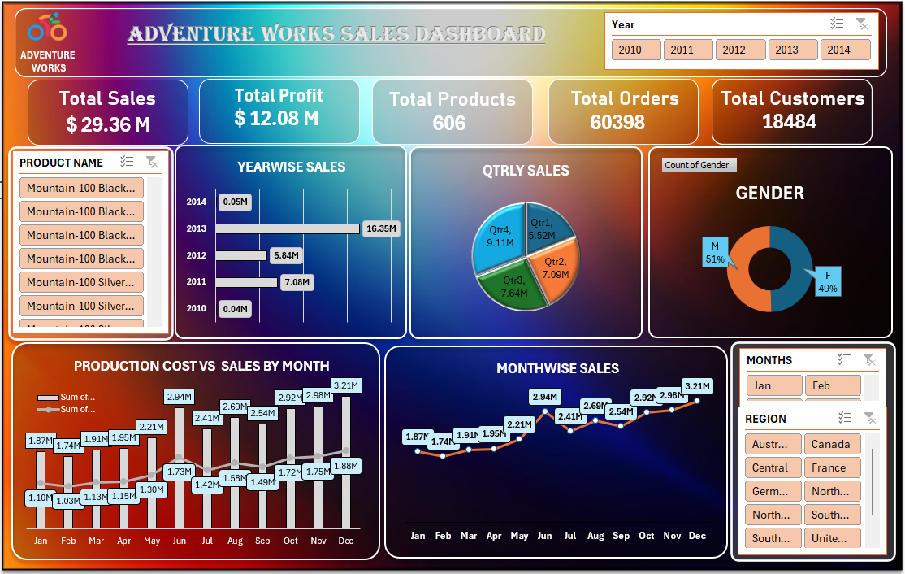
Excel Dashboard

Slide 12
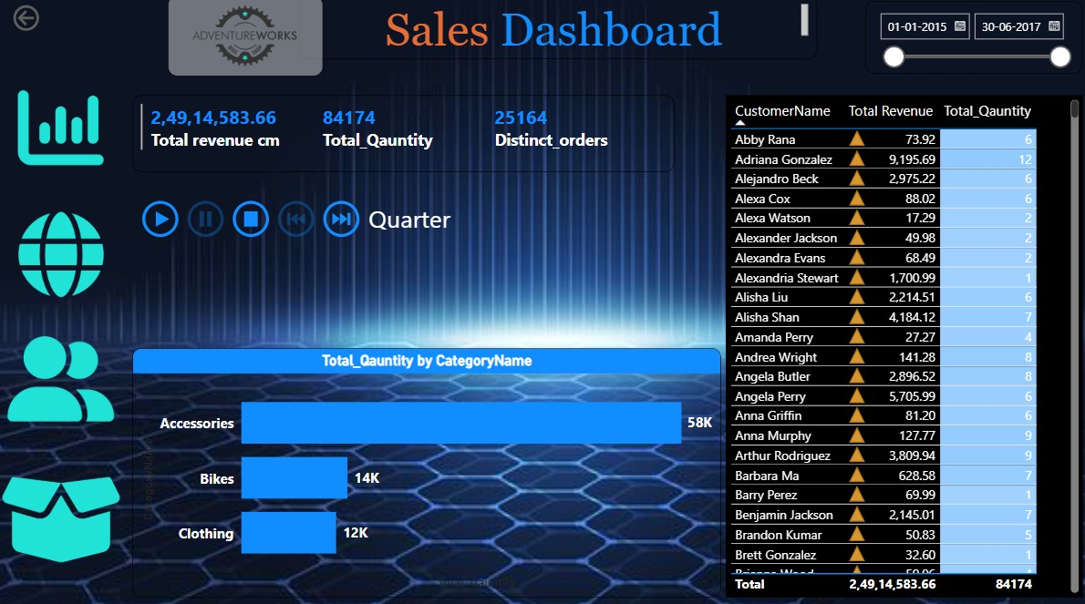
Powerbi Dashboard

Slide 13
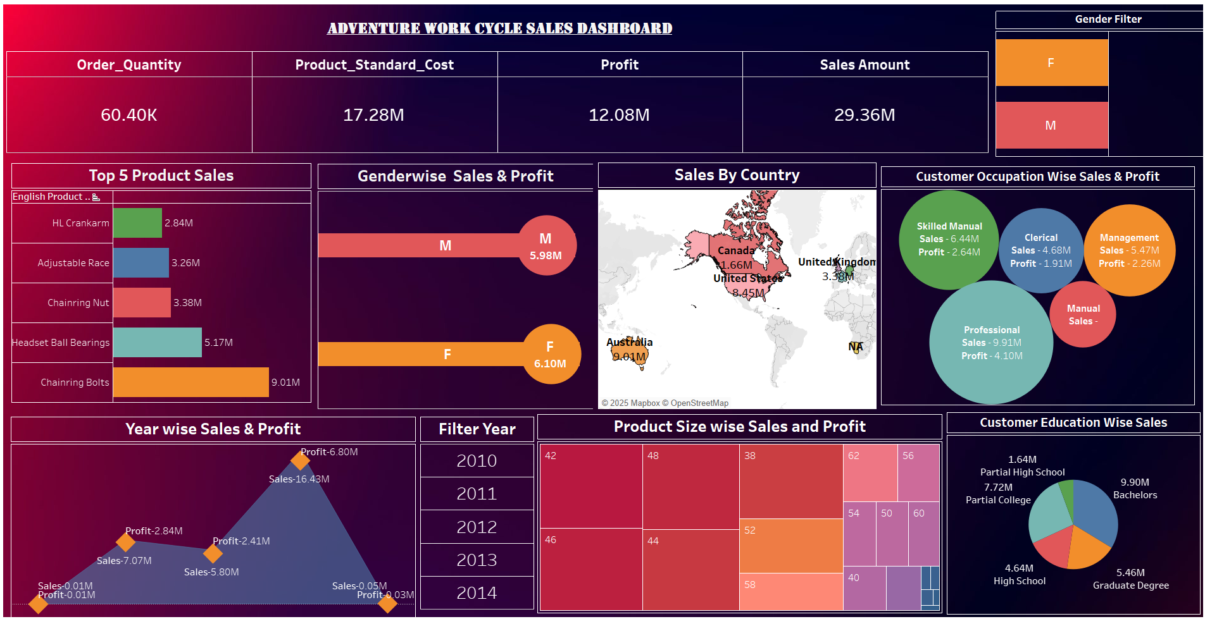
Tableau Dashboard

Slide 14

Sales peak in Nov-Dec, while Jan-Feb sees a dip, indicating seasonal demand fluctuations.
Accessories contribute the highest sales, with Black, Red, and Yellow being the most popular product colors.
Top 10 customers drive significant revenue, emphasizing the need for retention strategies.
Sales grew consistently from 2010-2013 but slowed in 2014, requiring market expansion.
Profit margins vary due to discounts, impacting overall revenue.
Insights

Slide 15

Leverage peak seasons with targeted promotions and introduce off-season discounts.
Focus on best-selling products and colors to optimize inventory and marketing.
Enhance customer loyalty programs and personalized offers for top buyers.
Strengthen marketing in underperforming regions to expand sales.
Optimize discount strategies to balance revenue and profitability.
Use data-driven insights for better forecasting and strategic decisions.
Recommendations

Slide 16

The Adventure Works Sales Analysis Project offers a comprehensive view of the company’s sales performance across time, products, customers, and regions. By integrating and analyzing data from multiple sources—including sales, product, customer, and date tables—we uncovered valuable insights into seasonal trends, top-performing products, customer buying behavior, and regional sales performance. Key metrics like Sales Amount, Production Cost, and Profit were calculated to understand business efficiency. Interactive dashboards and visualizations provided clear visibility into patterns, enabling data-driven decisions to boost growth and profitability.
Summary

Slide 17

This project highlights the power of data analytics in transforming raw sales data into meaningful insights. By leveraging tools like Excel and Power BI, Adventure Works can now make informed decisions that enhance customer engagement, improve inventory planning, and maximize profits. Moving forward, the company can continue to refine its strategy using these insights, ensuring smarter growth and sustained success in a competitive market
Conclusion

Slide 18
Timeline
Mon | Tue | Wed | Thu | Fri | Sat | Sun
15 Mar 25
Project Kick-off Meeting & Understand the Dataset and KPI’s
22 Mar 25
Implementation of KPI’s using Excel
29 Mar 25
Implementation of KPI’s using Tableau and SQL
05 Apr 25
Implementation of KPI’s using Power Bi
12 Apr 25
Final Presentation of the Project

Slide 19





